Slide 1
Kacha Bazar . Com A ONLINE SHOPING SYSTEM

Slide 2



Presented by
Md Asaduzzaman Masum
ID :- CSE 06307433
Md Shamim
ID :- CSE 06307456
Toufiq Anam Fahim
ID :- CSE 06307436

Slide 3
Data Flow Diagram
Data Flow Diagram of our online shoping System.

Slide 4
Goals of DFD
graphically represents the flow of data in a business information system.
DFD describes the processes that are involved in a system to transfer data from the input to the file storage and reports generation
Create or obtain an accurate and reliable narrative.
From the narrative, create a complete table of entities and activities.
Draw a context diagram with external entity boxes by distinguishing carefully between internal and external entities.

Slide 5
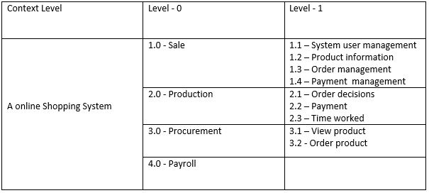
Decomposition of Data Flow Diagrame

Slide 6
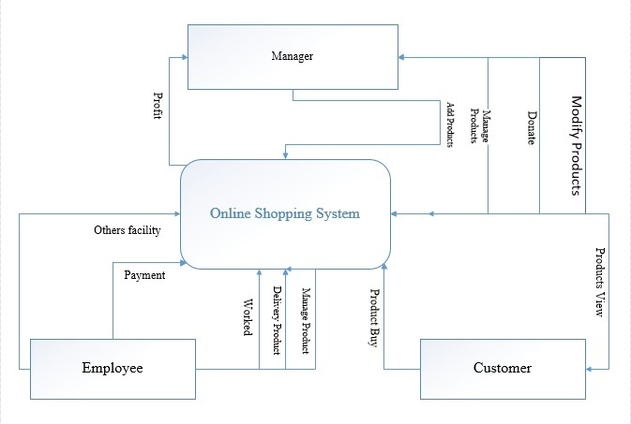
Context Level

Slide 7
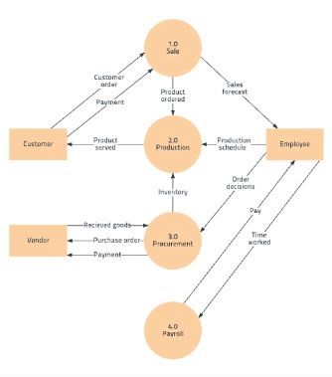
DFD Level-0

Slide 8
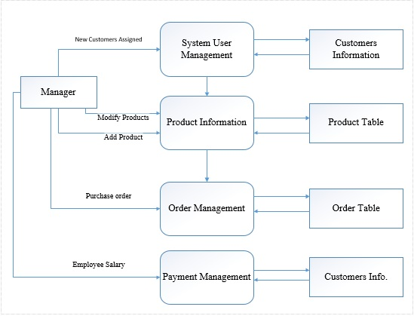
DFD Level-1

Slide 9
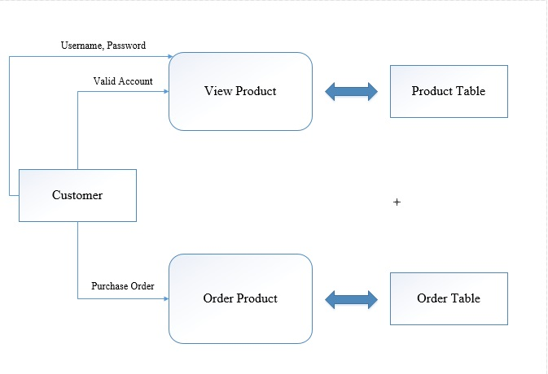
DFD Level 1

Slide 10
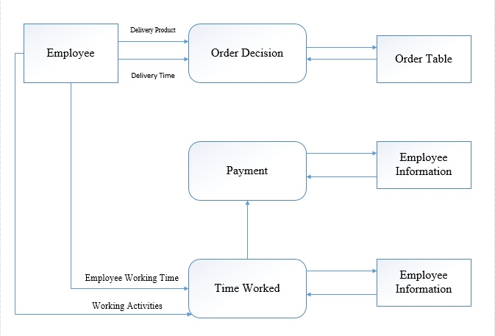
DFD Level 1

Slide 11
Summary of the Article
Software analysis is a way to identify actual business requirements. Software analyst always uses several graphical techniques to express a software system. One of the most accepted method is to draw a set of data flow diagram. A data flow diagram(DFD) uses several graphical symbols to display how the data transfers into a software system. There are several other graphical tools such as object modeling entity relationship diagram etc.. Here we are going to glance at Data flow diagram and its symbols.

Slide 12

Thank u for having with us?

